Slide 1
Module 3: Deploying to Production with AWS and Containers
1

Slide 2
Major Cloud Providers
•
Azure
Google AWS
•
•
2

Slide 3
AWS has many Services
3

Slide 4
AWS Beneﬁts
•
One of the ﬁrst cloud providers
Massive scale
Innovator with news features and services Lots of tools - good dev experience
Almost a standard with lots of expertise, best practices, experts, books, etc.
•
•
•
•
4

Slide 5
AWS Services for Containers
•
Elastic Compute Cloud (EC2)
Elastic Container Service (ECS) Elastic Container Registry (ECR) Elastic Beanstalk Containers - PaaS Docker EE for AWS
Relational Database Service (RDS)
•
•
•
•
•
5

Slide 6
Do It Yourself approach
EC2
•
Amazon Linux or other AMI + Docker Engine
Docker image (AMI)
CloudFormation, AWS CLI or web console User Data to install Docker Engine
•
•
•
6

Slide 7
Managed container service
ECS
Elastic Container Service
•
Monitors containers
Allows ELB
Allows autoscaling Allows health checks
•
•
•
7

Slide 8
Storage for container images which can be used with EC2, ECS or other services
ECR
Elastic Container Registry
10

Slide 9
Elastic BeanStack
PaaS
Ideal for small services with few containers.

Slide 10
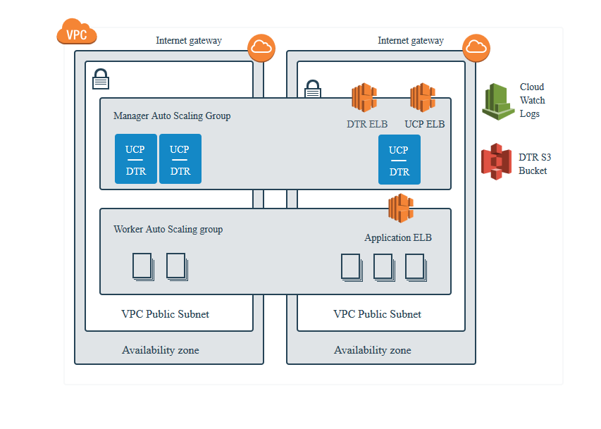
Docker Enterprise Edition
CloudFormation blueprint:
https://docs.docker.com/datacenter/install/aws/
https://store.docker.com/editions/enterprise/docker-ee-aws

Slide 11
Can be used with other services. Allows for managed databases.
RDS
Relational Database Service

Slide 12
Let's cover ECS + ECR usage

Slide 13
AWS EC2 Container Services
Tasks
Clusters
Registries

Slide 14
Registry
Where developers store their images. Allows for versioning and tagging.

Slide 15
Task
Task deﬁnition has info about images, env vars and network.

Slide 16
Cluster
Container cluster is like an EC2 instance where containers run.

Slide 17
Service
Container service makes sure your containers from task are running in a cluster. ELB and autoscaling group can be added to a service.

Slide 18
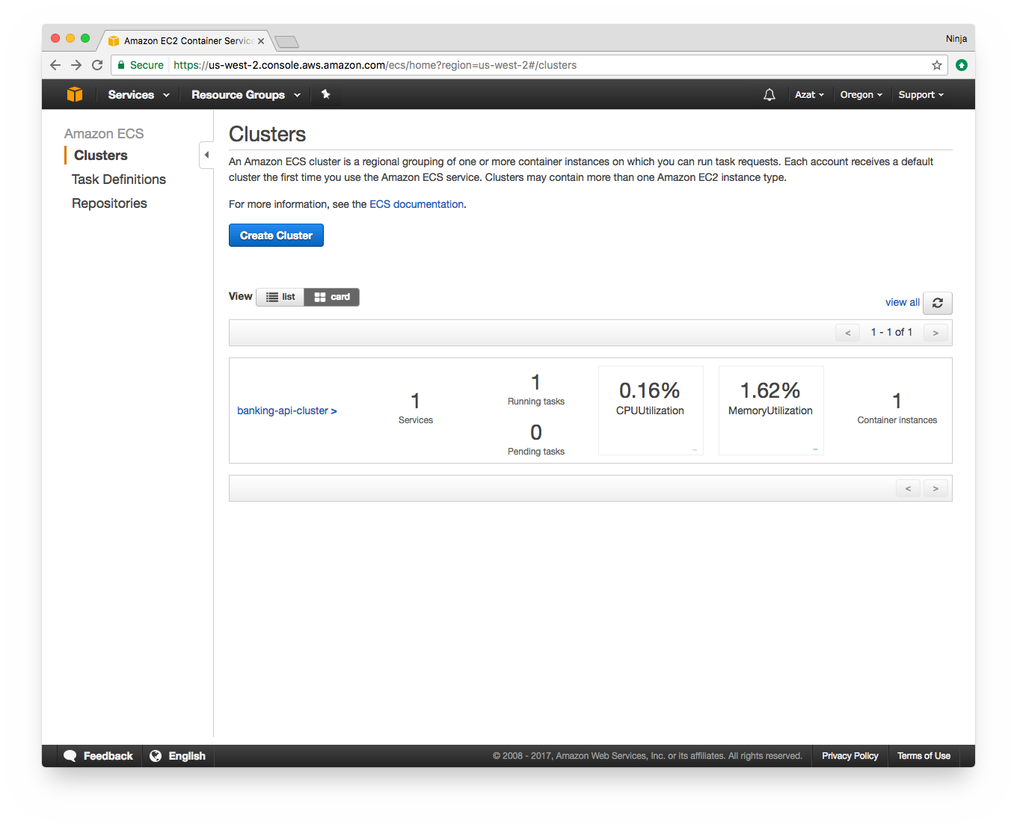

Slide 19
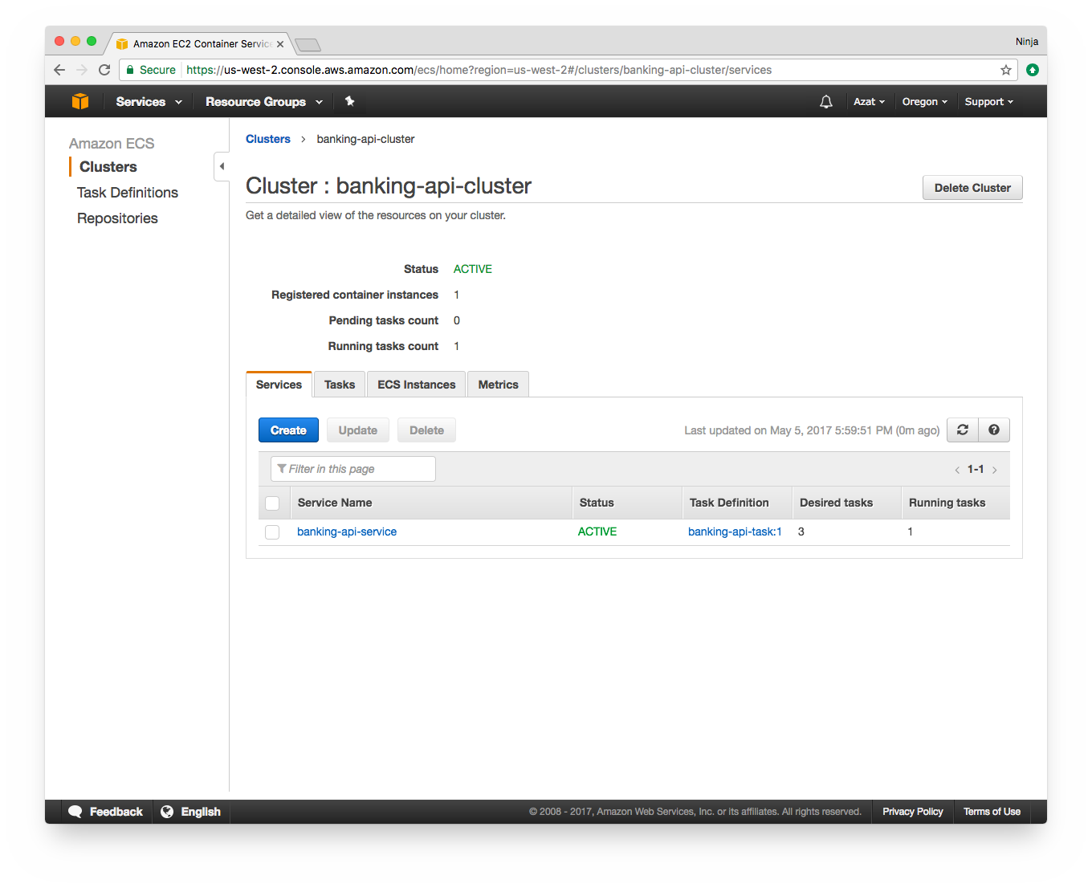

Slide 20
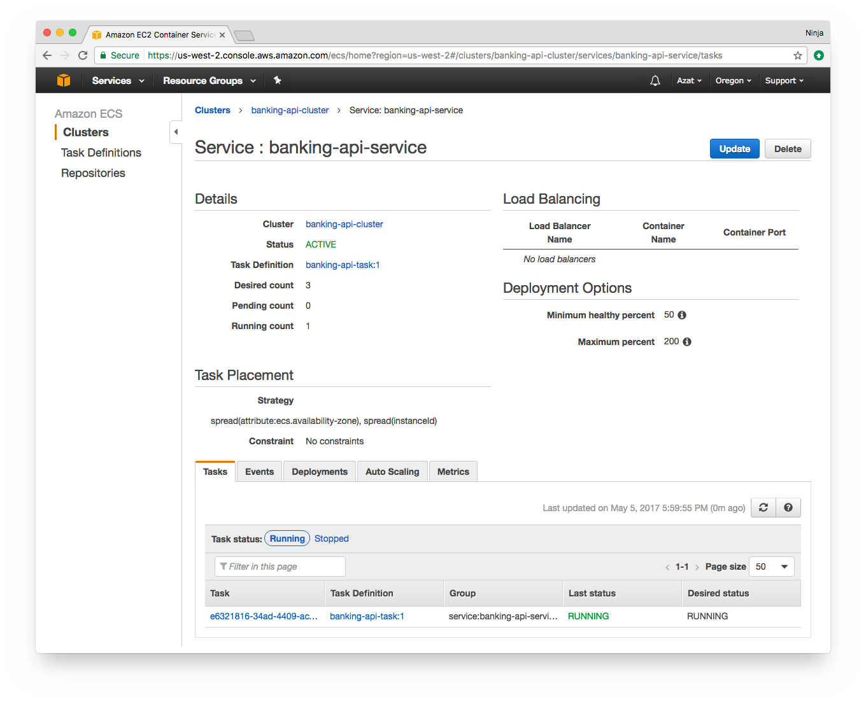

Slide 21
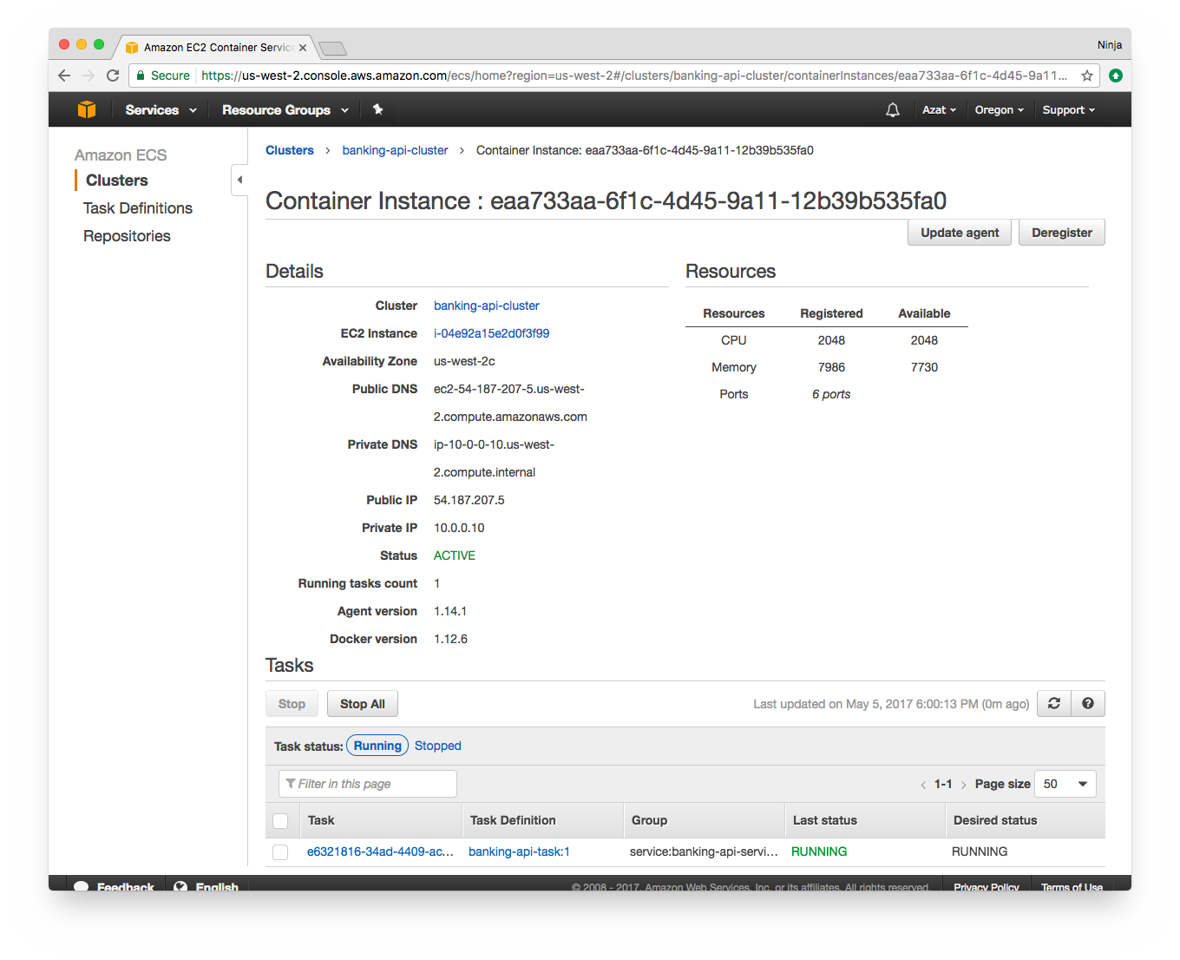

Slide 22
AWS is vast…
You should have access to Elastic Load Balancer, multi-availability zone deployment, Continuous Delivery S3, and managed database services.
These services can be used to deploy containers and applications without having to directly manage instances!

Slide 23
Summary
Use Env Vars
Make your Dockerﬁle work for dev and prod to use the same image
Use Docker networks or link in AWS ECS to share services for one project

Slide 24
Lab 2: AWS Containers
Task: Deploy two containers (API and DB) which connect using ECR and EC2 ECS.
Detailed instructions and link are in labs/2-aws-containers.md
Time to ﬁnish: ~20 min ☁

Slide 25

Congrats! !

